Slide 1


READING EYE Group ID : 19_20-J 17
Document Reading System
for
Blind people

Slide 2
Group details
Group ID - 19-20-J 17
IT 16 1021 56 - Dinuka Ekanayake
IT 16 1763 48 - Ishan Kalansooriya
IT 16 1657 62 - Sasmitha Kularathne
IT 16 0793 28 - Rashinka Fernando
Supervisor - Ms. Suranjini de Silva
Co-supervisor - Dr. Anuradha Jayakody

Slide 3
OVERVIEW
Introduction
Research Problem
Objectives
Methodology
Functionalities
Technologies
Requirements

Slide 4
Introduction
Our research is mainly focused on visually impaired people.
As you already know, visually impaired people use Braille system to both read and write.
To narrow down a large scope, we focused on their reading.
Visually impaired people use Braille formatted books to read. But this format is not available for all the books in the world.
Designing a Braille book is difficult and therefore highly expensive.

Slide 5
Introduction cont.
Research Problem
Reading is an easier task for a sighted person and most of us take it for granted. Have you ever wondered how it is with a blind person?
Use of centuries old slow Braille code reading in this modern society.
Inaccessibility of Braille format of any book.
Most of modern systems only support text reading.

Slide 6
Introduction cont.
Things we are going to do:
Extracting graphical regions from the document image.
Securing the client-server connection.
Reading natural images using deep learning.
Reading chart contents.
Reading equations.
Reading tabular information.

Slide 7
Objectives
Main objective
Facilitate visually impaired people to read printed documents as sighted people.
Specific Objectives
Make documents more accessible.
Enhance the security of the application.
Make reading an enjoyable experience rather than a tedious, unexciting one.
Encourage visually impaired people to read independently.

Slide 8
methodology

Slide 9
introduction
This research was conducted to implement a solution to read graphical content (charts, images, tables & equations) in a document.
Our intention is to facilitate visually impaired people to read printed documents as possible as sighted people.
Though there is an existing talking book application called Schmoozer, it is not capable of reading chart-based content.
As for the other features, we intend to provide more accurate & state-of-the-art functionalities.
Our solution is implemented as a mobile application to improve accessibility and usability.

Slide 10
methodology
Describes each functionality in the mobile application.
As we said earlier, there are several functionalities to read images, tables, charts & equations.
When a visually impaired user reads a printed document using our app, it captures the document image, encrypt it and upload to the server.
Then the server will be able to extract regions separately.
And read contents(e.g. charts) using the implemented functionalities.
Finally, all the output from features will be combined and converted to audio format.
Mobile application will play the generated audio narration to the reader.

Slide 11
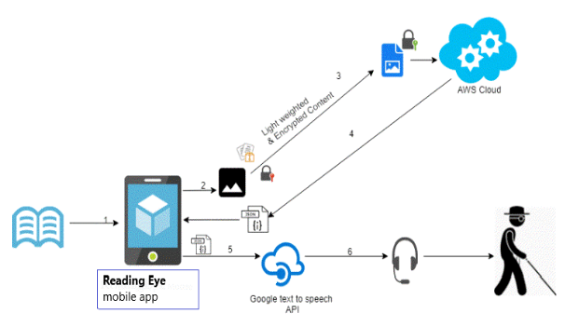
System architecture

Slide 12
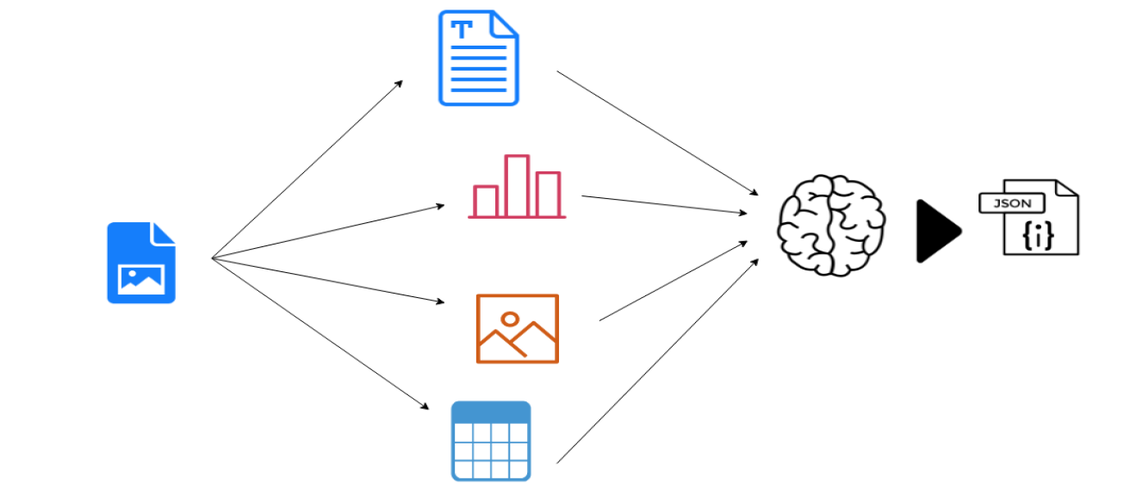
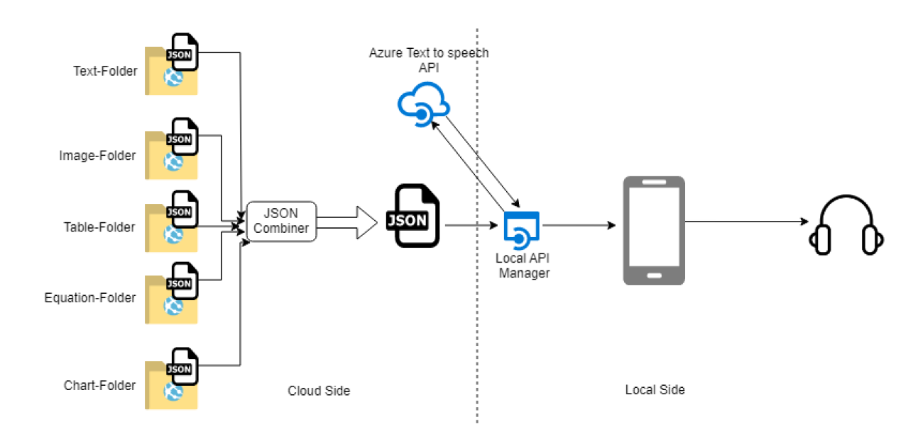
Contents Categorization
Audio Generation

Slide 13
identifying graphical content’s Regions
This feature identifies images, tables, charts and equations separately.
Main task is image segmentation. It separates meaningful individual objects from a captured digital image.
We used a specific machine learning technique to achieve this task of region identification, known as Mask RCNN.
Mask RCNN gives more accurate outputs than previous techniques.
The model we used generates bounding boxes and segmentation masks for each instance of an object in the image.
It's based on Feature Pyramid Network (FPN) and a ResNet101 backbone.

Slide 14
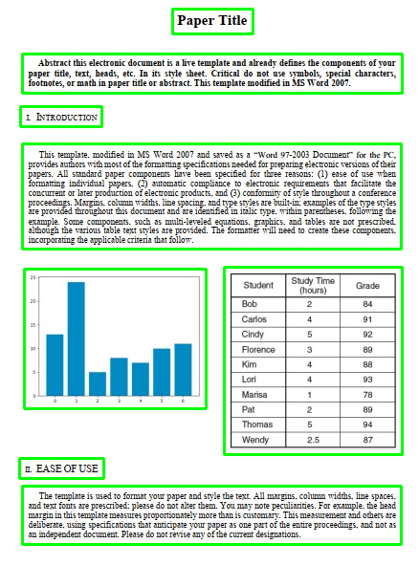
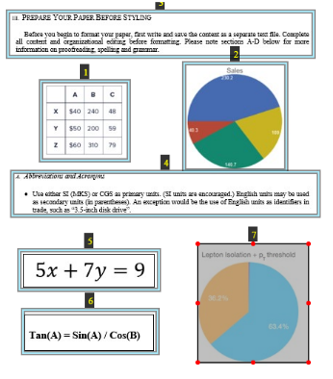
Results
Here is the result of region identification. This is a sample image of a document containing tables, charts, equations and paragraphs.
As you can see, this feature has correctly recognized the area of each content.

Slide 15
Reading images
This functionality is indented to read natural images in a document.
We used neural networks in deep learning to implement this functionality.
Convolutional neural networks are considered faster and give more accurate results than traditional machine learning algorithms.
We trained a specific model for this functionality.
It consists of an image model which contains data of the image and a language model which contains descriptions about the image.
To implement the language model, we used LSTM layers which are capable of remembering past data. It helps to generate word after word when describing the image.

Slide 16
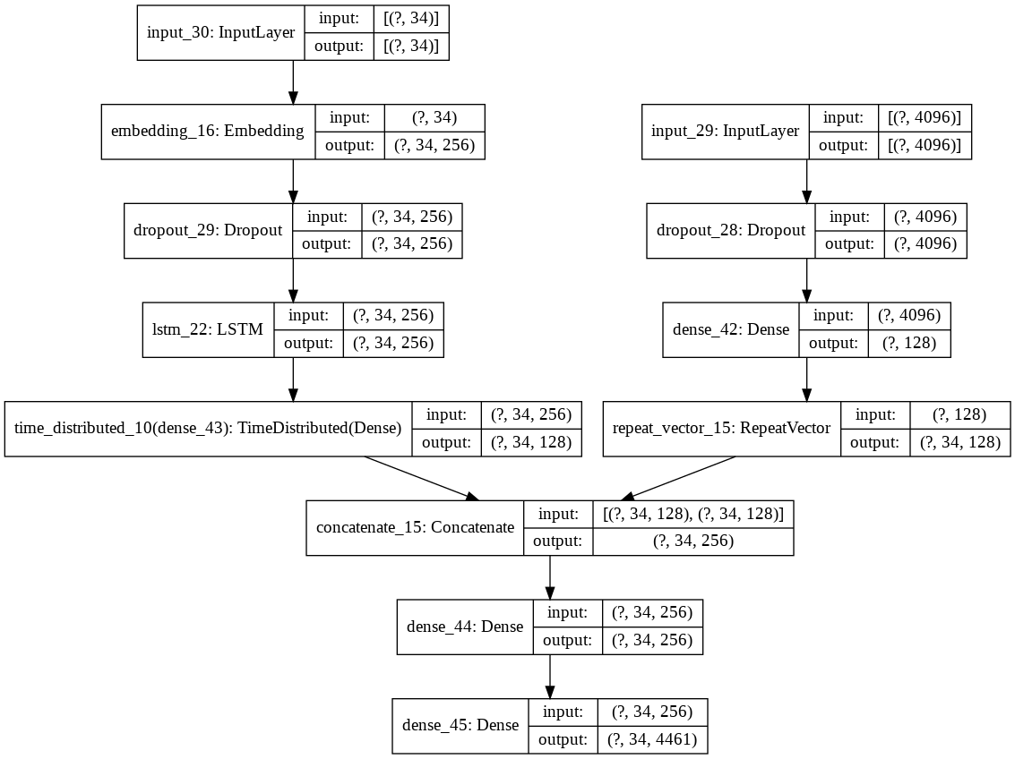
This is the structure of the trained model we used.
Language model
Image model
Combination of both model gives final output.

Slide 17
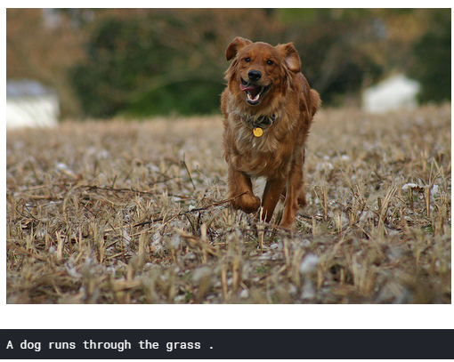
Results
Below is the result that was obtained from this image reading feature.
Real Captions :
A brown dog is running through a brown field.
A brown dog is running through the field.
A brown dog with his tongue wagging as he runs through a field.
A dog running in the grass.
Predicted Caption :
A dog runs through the grass.
Accuracy of model : 0.8742
Loss : 0.3707

Slide 18
Reading charts
The objective of this function is to read a chart.
We selected two specific and common chart types to carry out this research.
They are,
Pie Charts
Bar Charts
Initially, the obtained chart image files will be pre-processed before proceeding to the main identification stage.
Data in the image will be read by an OCR engine.
Since there two types, there will be two identification processes.

Slide 19
Pie Chart Identification
Firstly, we need to detect the edges in the chart.
The edge detection is performing through the Hough transform pattern recognition algorithm.
The algorithm detects circle positions and match their edges.
After applying OCR, function can read whatever inside the detected part in the chart image.
Bar Chart Identification
Otsu Binarization is applied for threshold with using various filters to smooth the image.
To extract bars from the image, local search algorithm is used.
It will generate the X and Y scale dimension of the bars.

Slide 20
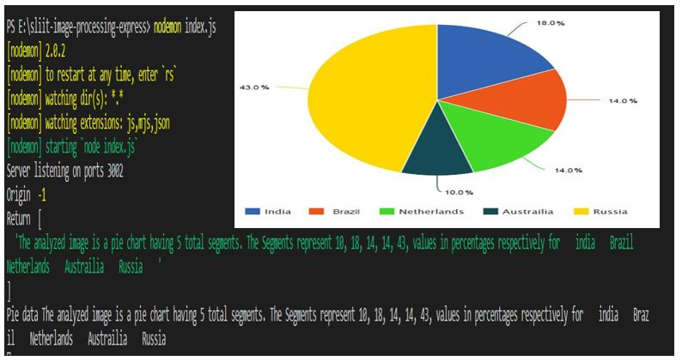
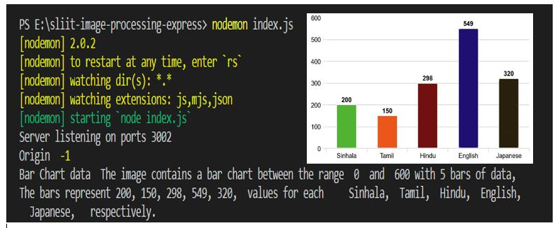
Results
Pie Charts
Bar Charts

Slide 21
Reading tables
The purpose of this functionality is reading tabular data in a document.
We used optical character recognition to read characters in the image.
And Morphological operations to crop and organize columns and rows separately.
So that we were able to use data in the table image to generate descriptions more meaningfully.
The function is capable of reading any column type. But the table must have horizontal and vertical lines.

Slide 22
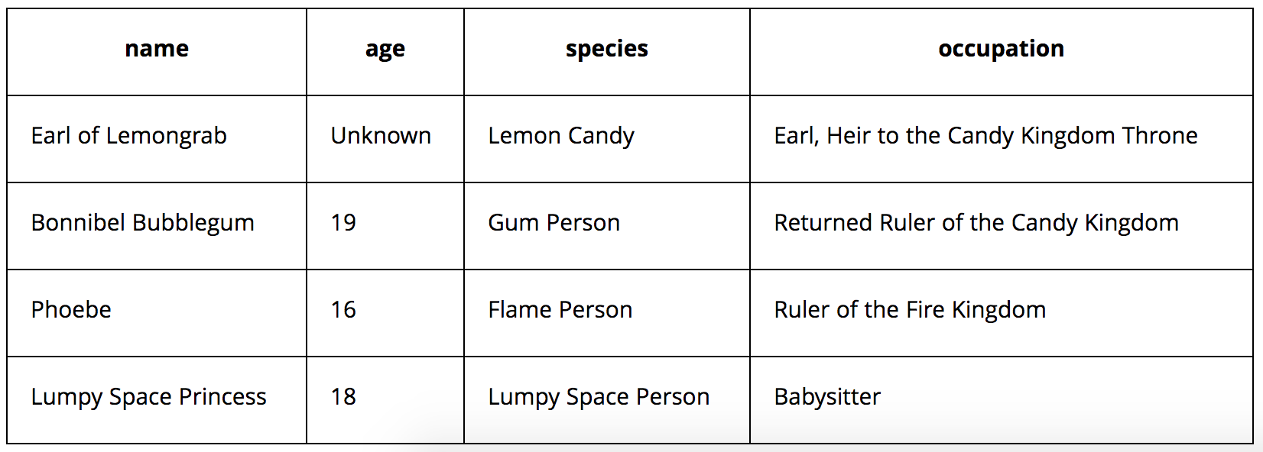
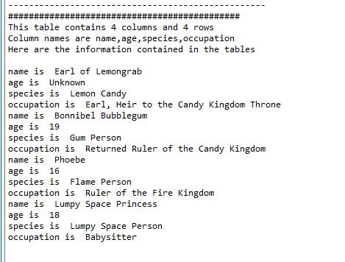
Results
These are the results that we got.
Original table image
Generated Description

Slide 23
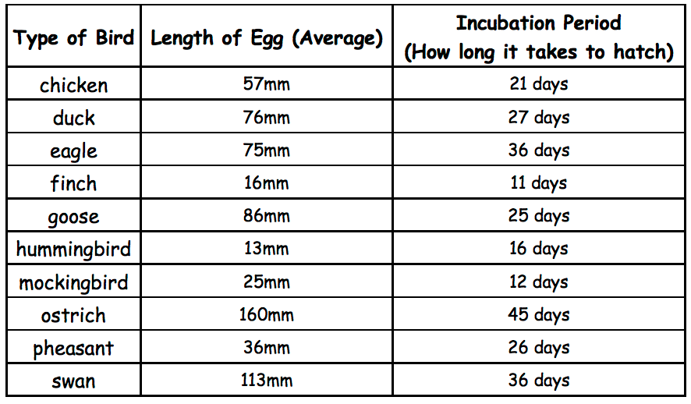
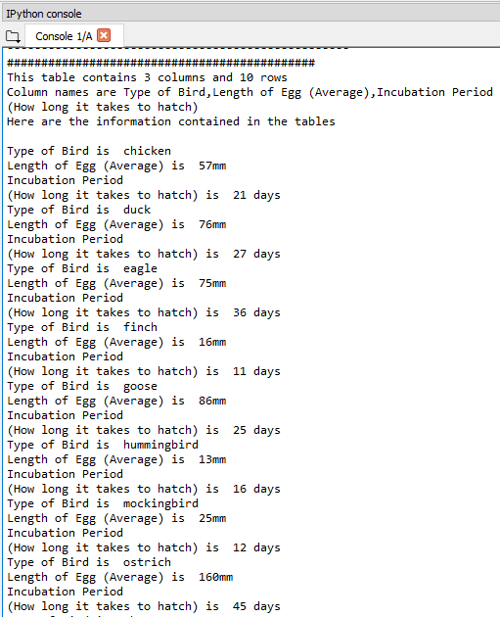
Here is how our function read a 3-column table.
Original Table Image
Tested Images : 10 Correct images : 10
Accuracy : 100%
Generated Description

Slide 24
Reading equations
The main purpose is to identify mathematical equations.
And to recognize the numerical constants, characters and mathematical operators contained in the equation.
As usual characters will be read by OCR engine.
Finally, function will generate a description about the equation and saves it in a JSON file with separately identified numerical constants, characters and mathematical operators.

Slide 25
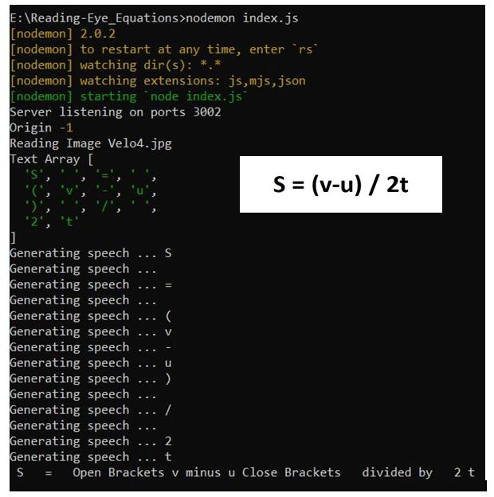
Results
Here is the result of equation reading function.
We sampled the famous equation.
S = (u-v) / 2t
This image shows the result that we got.

Slide 26
security
Encryption use for securing client-server connection
AES hybrid encryption algorithm is used
It is faster than the original AES algorithm
256 bit length key is used for encryption
Key exchange using Diffie-hellman algorithm

Slide 27
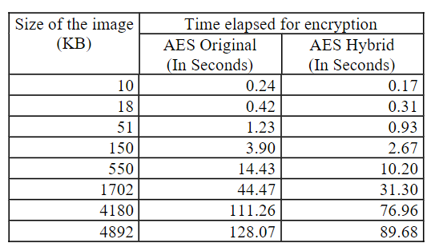
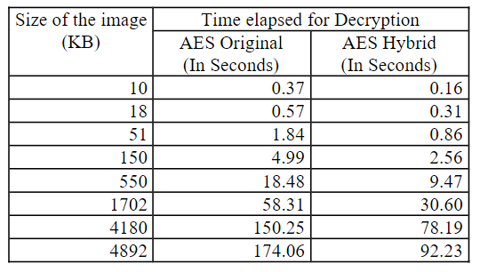
Results
Time elapsed for encryption
Time elapsed for decryption

Slide 28
Light weighting and pre-processing the image
Resize original image into 1000*1000 PIXELS
Split image into 200*200 pixels image segments
In server side denoising the image

Slide 29
Client-server connection
In client side
Resize the image
Split it
Encrypt it
Send to the server (like image streaming)
In server side
Receiving encrypted image segments
Decrypting them
Merge them to get the full image
Denoised the full image

Slide 30
Cloud policy
Password must be at least 10 characters long
Must include numbers, upper case letters, special characters
Must not use personal information( birthdays, NIC number, name, organization name, license plate numbers)
Must not include meaning full words
Must include numbers in username
Give minimum privileges to users

Slide 31


Technologies
Programming language : Python 3,Java
Mobile app : Android
Other Tools & Libraries:
TensorFlow
Keras
Open CV
Tesseract OCR
Google Text-to-Speech API
MS Azure to host the server
IDEs :
Android Studio
Google Colab & Kaggle Notebooks
Anaconda python distribution
Spyder IDE
Postman

Slide 32
requirements
We implemented a mobile application that can be operated on Android platform.
Therefore, the user should have a smart phone to use our app.
Android API should be newer as older versions will not be supported.
Having connected to Internet is a must.
As the server is located in cloud environment and we used text-to-speech API which are required to use internet all the time.

Slide 33
Thank you!!

